Slide 1

Department of Information Technology
A.P. Shah Institute of Technology
G.B.Road,Kasarvadavli, Thane(W), Mumbai-400615
UNIVERSITY OF MUMBAI
Academic Year 2019-2020

Slide 2
A Project Report on
Sentimental Analysis on Social Media
Submitted in partial fulfillment of the degree of
Bachelor of Engineering(Sem-8)
in
INFORMATION TECHNOLOGY
By
Dilesh Tanna(16104064)
Manasi Dudhane(16104068)
Amrut Sardar(15104050)
Under the Guidance of
Prof. Kiran Deshpande Prof. Neha Deshmukh

Slide 3
1.Project Conception and Initiation

Slide 4
1.1 Abstract
Social media consists of various kinds of emotions and sentiments of its users in the form of electronic media
Analyse the reactions or sentiments of the users on a certain post is also a challenging task.
Our project aims to automate this task of analysing the reactions and the posts and generate a report based on the outcome.
Every post/reaction/comment would be rated based on the sentiments behind it and the appropriate admin would receive the reports which can be used for the future actions.
Creating a user friendly platform by providing the user’s various features.

Slide 5
1.2 Objectives
To analyse user behaviour by their social media activity and predict their future behaviour.
To predict alarming behaviours like depression through their social media activities.
To give user the privilege to share post on various platforms.
To provide admin the user’s engagement by the scale of negative to positive.
By user’s interactions in the feed , his/her home page will get motivational quotes.
To create a centralised platform for the college for its social media activities.
According to the outcome, future actions will be taken by guidance/counsellor.

Slide 6
1.3 Literature Review
Paper Title: VADER: A Parsimonious Rule-based Model for Sentiment Analysis of Social Media Text .
Authors: C.J. Hutto Eric Gilbert
Publication details : Eighth International Conference on Weblogs and Social Media (ICWSM-14). Ann Arbor, MI, June 2014.
Findings: VADER, a simple rule-based model for general sentiment analysis, and compare its effectiveness to eleven typical state-of-practice benchmarks including LIWC, ANEW, the General Inquirer, SentiWordNet, and machine learning oriented techniques relying on Naive Bayes, Maximum Entropy, and Support Vector Machine (SVM) algorithms.

Slide 7
Paper Title : Sentiment Analysis of Social Networking Sites (SNS) Data using Machine Learning Approach for the Measurement of Depression.
Authors: Anees Ul Hassan, Jamil Hussain, Musarrat Hussain, Muhammad Sadiq, Sungyoung Lee
Publication details : 2017 International Conference on Information Communication Technology Convergence.
Findings: They propose a system that uses Social Network Sites as a source of data and screening tool to classify the user using Machine learning according to the UGC on SNS.

Slide 8
1.4 Problem Definition
To design a social media platform by using NLP sentiment analysis tool to analyse the users’ post/comments/reactions and rate them on a sentimental scale accordingly and also provide a user friendly platform that allows the users to share content on other social media platforms.

Slide 9
1.5 Scope
The posts created by the users would be analysed by the application and would help discover any alarming behaviour.
College/Universities will get analytical statistics of their students’ reactions to the posts shared by them.
The posts can be shared to multiple platforms through a single application.
The organizations can use the platform to get student reviews on their activities.

Slide 10
1.6 Technology stack
Mongodb / Postgres
Express
React
Node

Slide 11
1.7 Benefits for environment & Society
This platform will analyse the behaviour of the users and help detect any alarming behaviour.
Admins gets insights on their content thus helping them create effective and efficient content.
Based on the users’ behaviour on the application, they would see posts that would help them emotionally. For example, a depressed user would see motivational quotes.
A user can administer groups and pages and manage the relative users and keep a check on their well being.

Slide 12
2. Project Design

Slide 13
2.1 Proposed System
A social media platform with the ability to perform sentiment analysis for 'high level users' is the desired outcome of this project. The platform would allow almost all activities that a normal social platform does. The user would be able to share content and view other users' content and express their personal views on the same. A user can be enrolled into different groups such as a business or a university. The user would also be able to share content from one this platform to other social media platforms. The other aspect of the project is the sentiment analysis part where all the activities of a user in a group would be analyzed. The flow of the analysis is as follows:

Slide 14
2.2 Design(Flow Of Modules)
User Post, Comment or Reaction
Rated
Stored in
Database
Analysis
Action by Admin

Slide 15
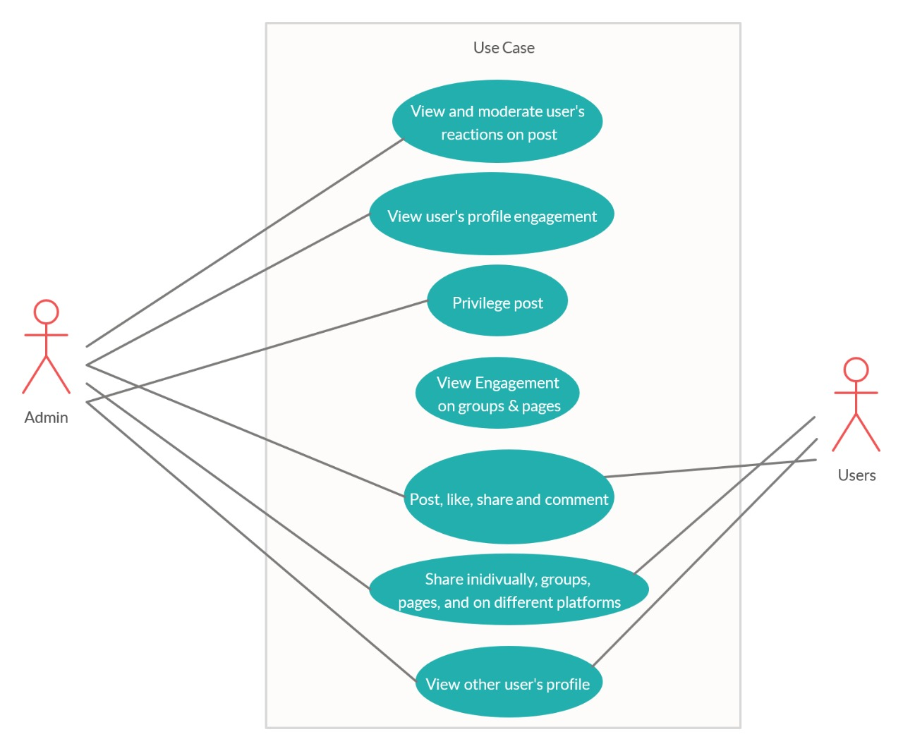
2.3 Use Case Diagram

Slide 16
2.3 Description Of Use Case
Admin can view and moderate user’s reactions on post. Can view user’s profile engagement and also groups & pages engagement. Admin has a special privilege to post. Post, Like, Comment and Share actions also with sharing post on different platforms.
Users can Post, Like, Comment and Share with option of sharing the post on different platforms along with option to share the posts individually and user can share it on groups and pages. Can view other user’s profile.

Slide 17
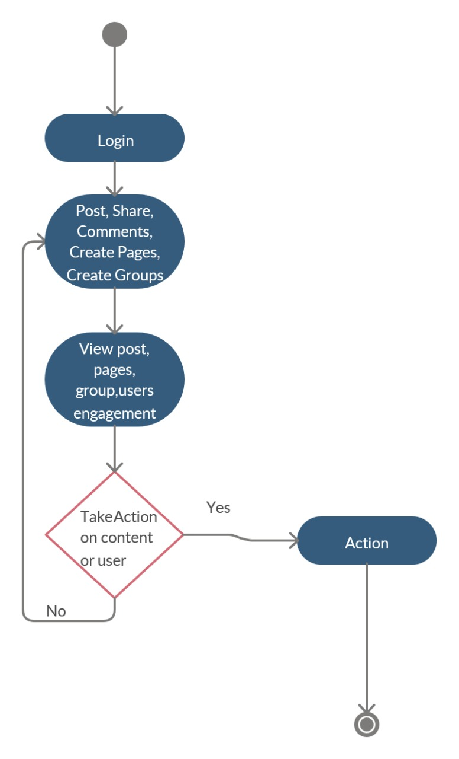
2.4 Activity diagram

Slide 18
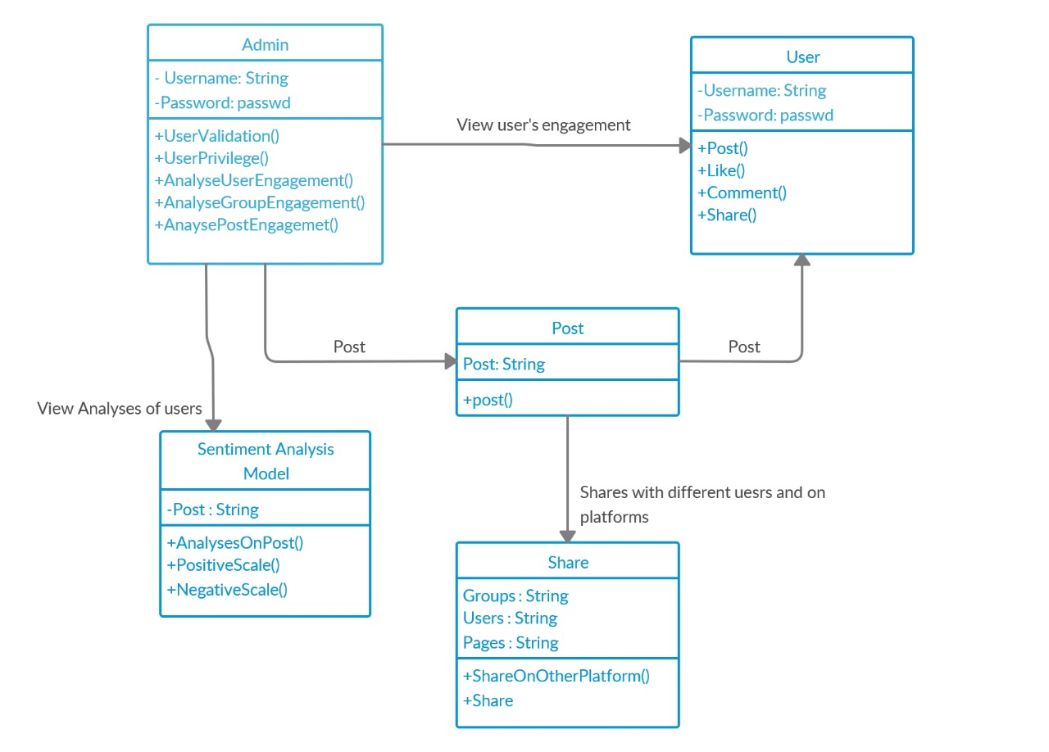
2.5 Class Diagram

Slide 19
2.7 Module-1 Post
The users can view and create new posts. Along with it, they can also share and react to all the posts that they see.
The user can post pictures, videos and audios along with text.

Slide 20
Module-2 Groups
The users can create different groups and share posts in the same.
Admin of the group will have the right to add or delete any member of that group.
Posts shared in the groups would only be visible to the members of the same group.

Slide 21
Module-3 Dashboard
The administrators can get a view of all the users belonging to their jurisdiction and look at their 'sentiment score'.
The sentiment score is the aggregate score based on the posts created by the user.
Judging by the score, the admin can tell if the user needs any special help.

Slide 22
Module-4 Profile
The users can see their own and other users' profile.
The profile view of the application would contain all the groups and pages administered by the user along with all the posts created by them.

Slide 23
Module-5 Notification
If the user ticks ‘mark as compulsory’ field, then the receiver will get the notification.
User will get notified by the bell icon in his/her home page.
Notifications will pop up in the home page and the user can click on that to take an action.

Slide 24
Module-6 Sharing
The users can Share their posts on Facebook or in other groups.
This would be done via Facebook APIs
Posts shared in the groups would only be visible to the members of the same group.

Slide 25
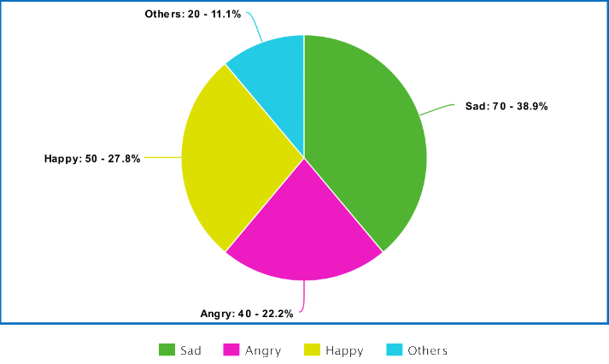
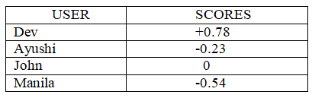
Result

Slide 26
2.7 References
Hutto C.J., Gilbert E., VADER: A Parsimonious Rule-based Model for Sentiment Analysis of Social Media Text, AAAI, 2014.
Anees Ul Hassan, Jamil Hussain, Musarrat Hussain, Muhammad Sadiq, Sungyoung Lee,’Sentiment analysis of social networking sites (SNS) data using machine learning approach for the measurement of depression’, 2017 International Conference on Information and Communication Technology Convergence (ICTC)
Persia, F., & D’Auria, D. (2017). A Survey of Online Social Networks: Challenges and Opportunities. 2017 IEEE International Conference on Information Reuse and Integration (IRI).

Slide 27
Rosa, R. L., Rodriguez, D. Z., Schwartz, G. M., de Campos Ribeiro, I., & Bressan, G. (2016). Monitoring system for potential users with depression using sentiment analysis. 2016 IEEE International Conference on Consumer Electronics (ICCE).

Slide 28
3. Future Scope

Slide 29
The scope of social networking is widening, and today it offers a strong support to the companies in providing the much desired touch of concern.
Future of social media networking brings exciting promises as expected from the experience of limited users.
By the use of sentimental analysis, the platform can be well analysed by user’s activity
College Universities will get analytical statistics of their students.
In campus recruitment, companies can consider the analysis made by the system.

Slide 30
Thank You

